Slide 1
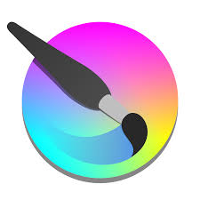
Krita –an introduction
By Probir Sir

Slide 2
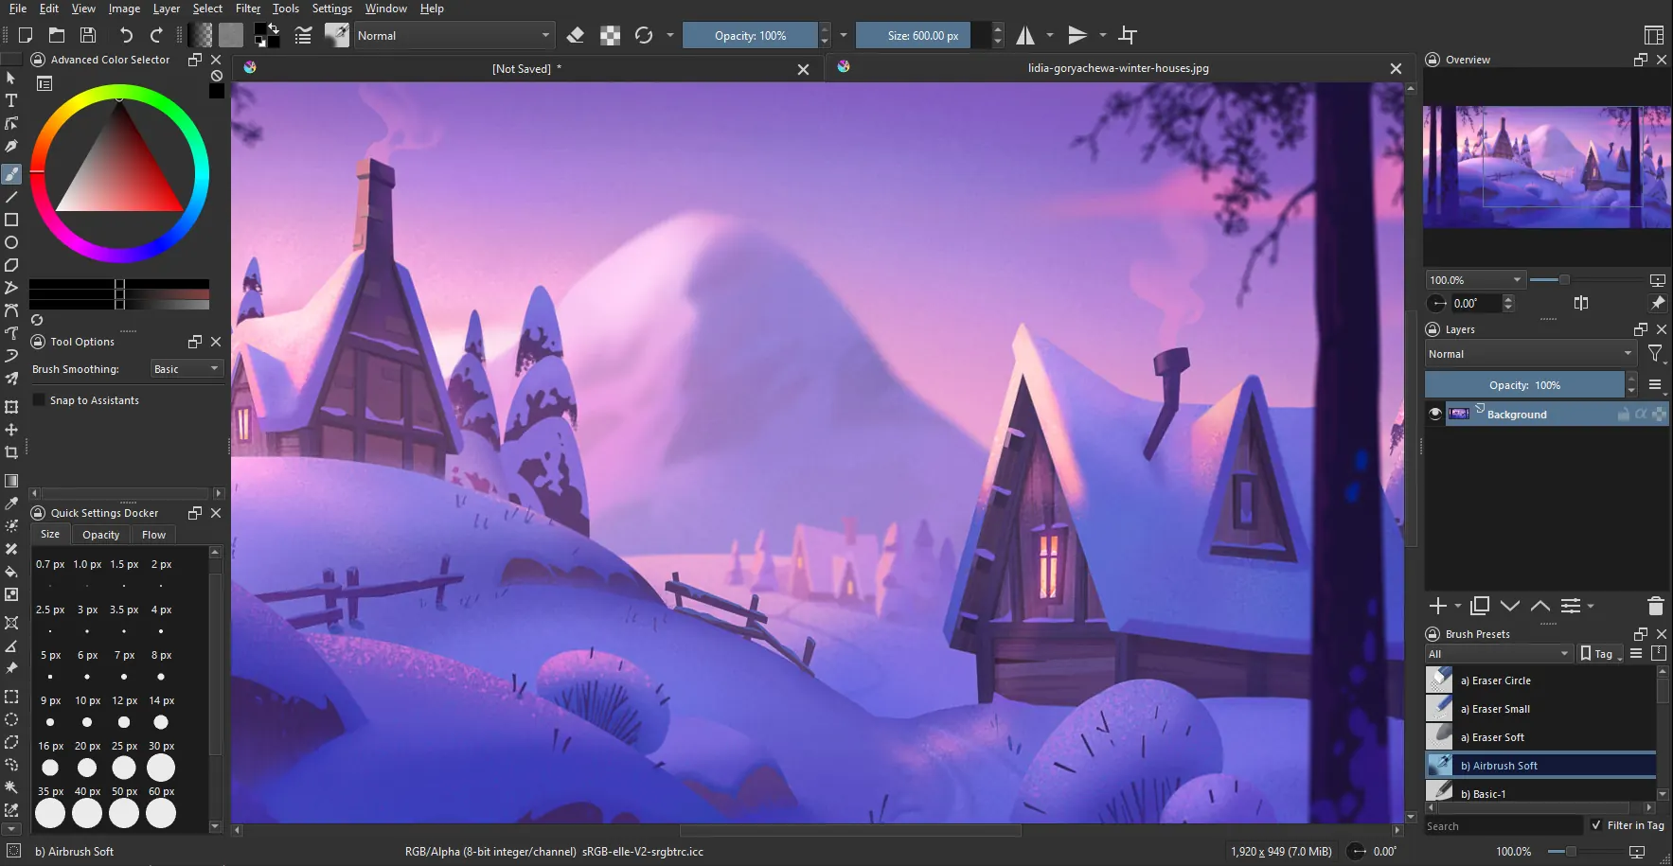
Topics to be covered
Features of Krita
Downloading and Installing Krita
Starting Krita
Components of the Krita Window
Creating Graphics and Shapes
Opening Krita Files
Closing Krita Files

Slide 3
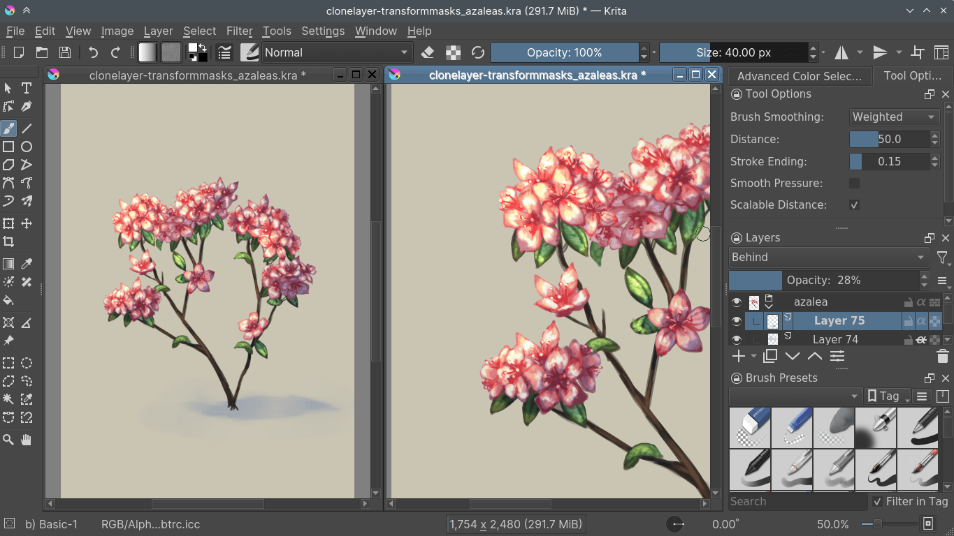
Introduction
Krita is a graphics design software.
It is open source and free of cost.
This is a raster graphics editor designed primarily for digital painting and 2D animation.
It's a powerful tool used by artists, designers, and creative professionals for various projects, from illustrations and concept art to comic books and animation.
Krita is known for its user-friendly interface.
Krita has extensive brush engine, and support for non-destructive layers and masks.

Slide 4
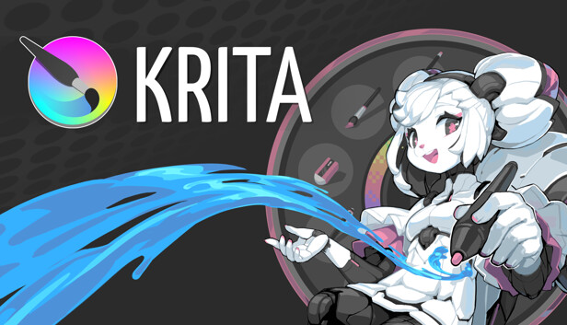
Features of Krita
User Interface: - Krita has an intuitive user interface. In Krita dockers and panels can be moved and customized. You can create your own shortcuts for commonly used tools.
Pop-Up Palette: - Allows us to pick colours and brush by right-clicking on the canvas.
Brush Stabilizers: - To smoothen the brush strokes Brush Stabilizers are used.
Brush Engines: - Krita's brush engine is highly customizable, allowing artists to create a wide range of effects and textures. It provides us with 9 unique brush engines.
Wrap-around mode: - Allows us to create seamless textures and patterns. We press W key to toggle wrap-around mode.
Resource Manager: - Enables sharing through import of Brushes and textures from other sources.

Slide 5
Downloading and Installing Krita
To download Krita we need to open Krita website by opening a browser like google chrome.
Krita website is : - https://krita.org/en/download
Click on the windows installer button and wait until the software is downloaded into your PC.
Then track the .EXE file or SETUP file of Krita and run the file by double clicking on it.
Follow the steps one by one given in the installation package.

Slide 6
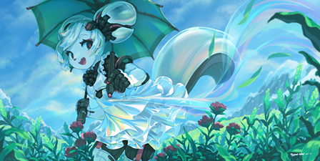
Starting Krita
Click on search box or press windows button then type Krita.
Krita executable file name will appear.
Click on it to open and run the application.
Create a new canvas from the file menu or press Ctrl + N.
A create new document box will appear.
In the Dimensions tab choose A4(300ppi) from the predefined drop down list.
Click on the create button.
Width, Height, Resolution and color Model can be set from the dimensions tab. Color profiles include RGB, Grayscale, CMYK.
From the Content Tab we can change the title of the document in Krita and can add layers, delete layers, can add background colour, background opacity.

Slide 7
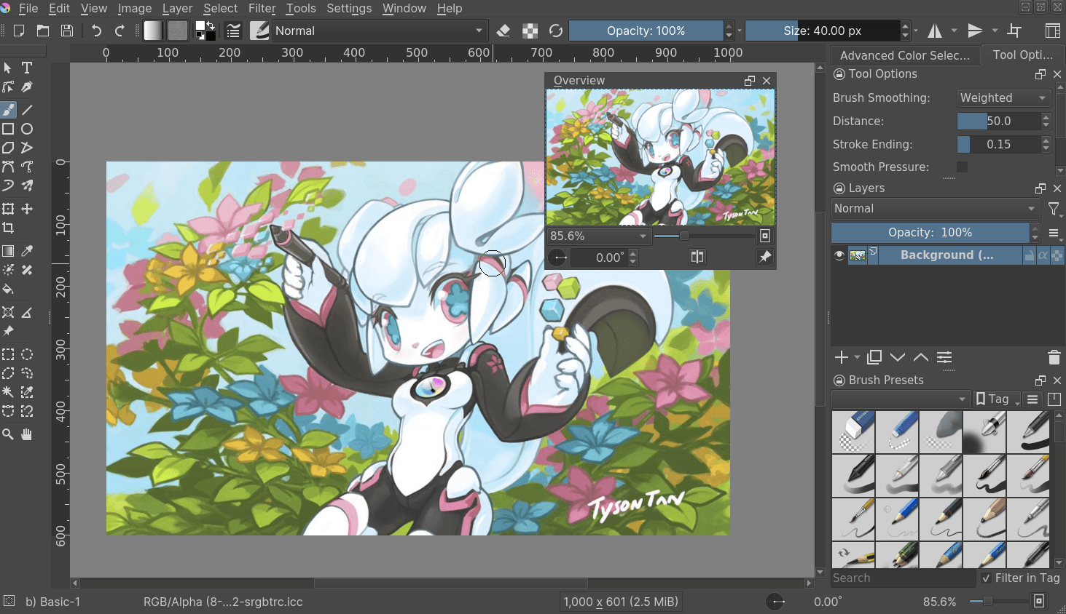
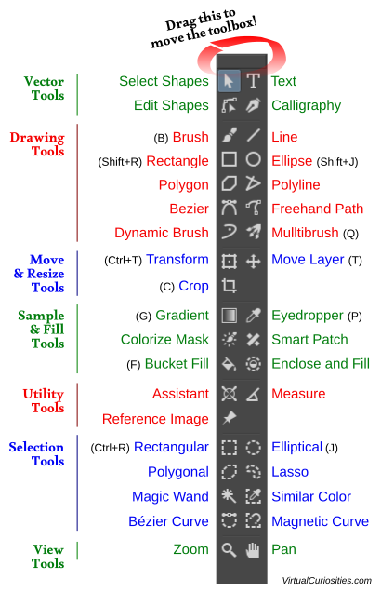
Components of the krita Window

Slide 8
Components of the krita Window
Title Bar: - At the top of the window title bar displays the name of the file.
Menu Bar: - Provides the commands grouped together to perform different tasks. File, Edit, View, Image, Layer etc. are examples.
Toolbar: - It is context specific, i.e. shows different options for the selected tool.
Toolbox: - Provides different tools to create, edit and enhance image.
Dockers: - provides more control over a tool by allowing different options and settings, like pick colours, manage layers and adjust tool options.
Canvas: - The main working white space where we can place an image for editing. An object outside the canvas area will appear after exporting or printing.

Slide 9
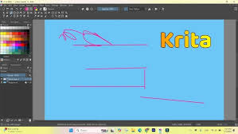
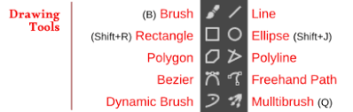
Creating Graphics and Shapes
Line Tool: - A Line tool is used to draw straight lines. Size option allow us to set the thickness of the line.
Select the line tool from the toolbox and draw lines in the canvas.

Slide 10
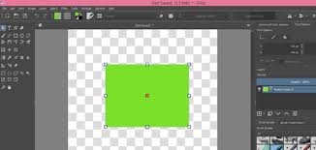
Creating Graphics and Shapes
Rectangle Tool: - The rectangle Tool is used to draw a rectangle or a square.
To draw a rectangle or square select this tool from toolbox and draw on the canvas by click and drag.
Fill, Outline and Size options will appear on the Tool Options Docker for the rectangle tool drawn or selected.

Slide 11
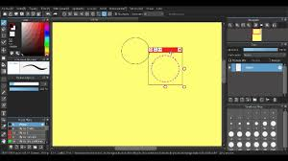
Creating Graphics and Shapes
Ellipse Tool: - This tool is used to draw a circle or ellipse.
The similar tool options are shown on the docker as was shown in the case of rectangle.

Slide 12
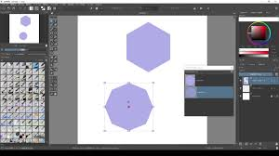
Creating Graphics and Shapes
Polygon Tool: - This is used to draw a polygon.
You can draw precise and customizable polygons using polygon tool.

Slide 13
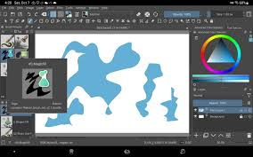
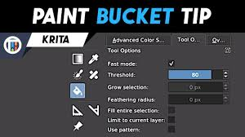
Creating Graphics and Shapes
Fill Tool: - This is used to fill areas of closed shapes or an object using solid color, gradient color or patterns.
Select the Fill tool and select the color to apply Fill tool.

Slide 14
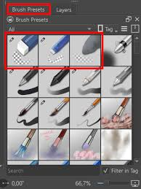
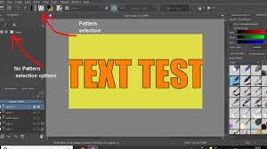
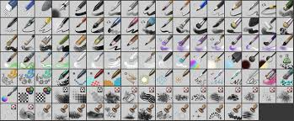
Creating Graphics and Shapes
Text Tool: - This is used to add any text in the Krita artwork.
Using Brushes: - By default brush tool is selected in Krita. This tool offers different types of Brushes in Krita. The Shortcut to select Brush tool is B.
Erasing in Krita: - Krita has a different method to erase an object. Select the Freehand Brush Presets and Brush Preset then select Eraser Brush presets. Using Eraser now you can erase by click and drag.

Slide 15
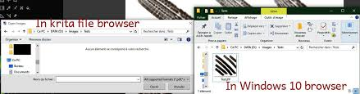
Opening Krita Files
Saving Krita Files: - After we create our image or editing any file we need to save it. In Krita we click on the File menu then click on Save or Save As. Browse for a location and give a name to click on save.
The default file extension of Krita file is .kra. We can export our file to .jpeg, .png, .pdf etc.
To open a saved file we again go to file menu and select open option. Open dialog box appears and by browsing select your file to click open.

Slide 16
Closing Krita Files
To close a file in Krita we follow these steps: -
Click on the File Menu
Click on the Close option.
Krita prompts for save the file if it is already not saved.
Opacity: - The quality of being difficult to see through.
Toggle: - To switch a feature on and off by pressing a key or button.

Slide 17
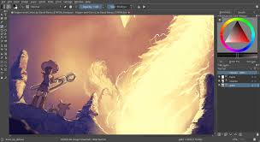
Conclusion
Krita is an open source software to create beautiful digital painting and image processing. This interesting software is totally free of cost to create digital painting and 2d animation. So working with Krita has an advantage that is not found in other paid version of digital image processing software. But due to open source there are some limited toolset to complete the tasks smoothly.

Slide 18


